Slide 1
Oracle Join Syntax

Slide 2
Objectives
After completing this appendix, you should be able to do the following:
  Write SELECT statements to access data from more than one table using equijoins and nonequijoins
  Join a table to itself by using a self-join
  View data that generally does not meet a join condition by using outer joins
  Generate a Cartesian product of all rows from two or more tables
Notes:
Oracle Database 11g: SQL Fundamentals I F - <number>
Objectives
This lesson explains how to obtain data from more than one table. A join is used to view information from multiple tables. Therefore, you can join tables together to view information from more than one table.
Note: Information about joins is found in the section on “SQL Queries and Subqueries: Joins” in Oracle Database SQL Language Reference 11g, Release 1 (11.1).

Slide 3

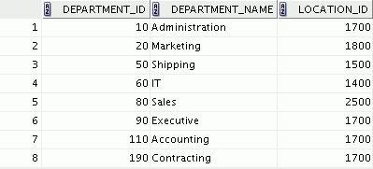

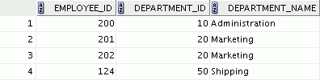

Obtaining Data from Multiple Tables
EMPLOYEES
DEPARTMENTS
…
…
Notes:
Oracle Database 11g: SQL Fundamentals I F - <number>
Obtaining Data from Multiple Tables
Sometimes you need to use data from more than one table. In the example in the slide, the report displays data from two separate tables:
Employee IDs exist in the EMPLOYEES table.
Department IDs exist in both the EMPLOYEES and DEPARTMENTS tables.
Department names exist in the DEPARTMENTS table.
To produce the report, you need to link the EMPLOYEES and DEPARTMENTS tables, and access data from both of them.

Slide 4
Cartesian Products
  A Cartesian product is formed when:
    A join condition is omitted
    A join condition is invalid
    All rows in the first table are joined to all rows in the second table
  To avoid a Cartesian product, always include a valid join condition in a WHERE clause.
Notes:
Oracle Database 11g: SQL Fundamentals I F - <number>
Cartesian Products
When a join condition is invalid or omitted completely, the result is a Cartesian product, in which all combinations of rows are displayed. In other words, all rows in the first table are joined to all rows in the second table.
A Cartesian product tends to generate a large number of rows and the result is rarely useful. Therefore, you should always include a valid join condition unless you have a specific need to combine all rows from all tables.
However, Cartesian products are useful for some tests when you need to generate a large number of rows to simulate a reasonable amount of data.

Slide 5
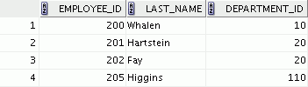
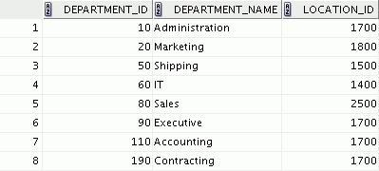




Generating a Cartesian Product
EMPLOYEES (20 rows)
DEPARTMENTS (8 rows)
…
Cartesian product:
20 x 8 = 160 rows
…
…
Notes:
Oracle Database 11g: SQL Fundamentals I F - <number>
Generating a Cartesian Product
A Cartesian product is generated when a join condition is omitted. The example in the slide displays the last name of the employee and the department name from the EMPLOYEES and DEPARTMENTS tables, respectively. Because no join condition has been specified, all rows (20 rows) from the EMPLOYEES table are joined with all rows (8 rows) in the DEPARTMENTS table, thereby generating 160 rows in the output.
SELECT last_name, department_name dept_name
FROM employees, departments;
…

Slide 6
Types of Oracle-Proprietary Joins
  Equijoin
  Nonequijoin
  Outer join
  Self-join
Notes:
Oracle Database 11g: SQL Fundamentals I F - <number>
Types of Joins
To join tables, you can use Oracle’s join syntax.
Note: Before the Oracle9i release, the join syntax was proprietary. The SQL:1999–compliant join syntax does not offer any performance benefits over the Oracle-proprietary join syntax.
Oracle does not have an equivalent syntax to support the FULL OUTER JOIN of the SQL:1999–compliant join syntax.

Slide 7
Joining Tables Using Oracle Syntax
Use a join to query data from more than one table:
  Write the join condition in the WHERE clause.
  Prefix the column name with the table name when the same column name appears in more than one table.
SELECT table1.column, table2.column
FROM table1, table2
WHERE table1.column1 = table2.column2;
Notes:
Oracle Database 11g: SQL Fundamentals I F - <number>
Joining Tables Using Oracle Syntax
When data from more than one table in the database is required, a join condition is used. Rows in one table can be joined to rows in another table according to common values that exist in the corresponding columns (that is, usually primary and foreign key columns).
To display data from two or more related tables, write a simple join condition in the WHERE clause.
In the syntax:
table1.column Denotes the table and column from which data is retrieved
table1.column1 = Is the condition that joins (or relates) the tables together
table2.column2
Guidelines
When writing a SELECT statement that joins tables, precede the column name with the table name for clarity and to enhance database access.
If the same column name appears in more than one table, the column name must be prefixed with the table name.
To join n tables together, you need a minimum of n-1 join conditions. For example, to join four tables, a minimum of three joins is required. This rule may not apply if your table has a concatenated primary key, in which case more than one column is required to uniquely identify each row.

Slide 8
Qualifying Ambiguous Column Names
  Use table prefixes to qualify column names that are in multiple tables.
  Use table prefixes to improve performance.
  Use table aliases, instead of full table name prefixes.
  Table aliases give a table a shorter name.
    Keeps SQL code smaller, uses less memory
  Use column aliases to distinguish columns that have identical names, but reside in different tables.
Notes:
Oracle Database 11g: SQL Fundamentals I F - <number>
Qualifying Ambiguous Column Names
When joining two or more tables, you need to qualify the names of the columns with the table name to avoid ambiguity. Without the table prefixes, the DEPARTMENT_ID column in the SELECT list could be from either the DEPARTMENTS table or the EMPLOYEES table. Therefore, it is necessary to add the table prefix to execute your query. If there are no common column names between the two tables, there is no need to qualify the columns. However, using a table prefix improves performance, because you tell the Oracle server exactly where to find the columns.
Qualifying column names with table names can be very time consuming, particularly if table names are lengthy. Therefore, you can use table aliases, instead of table names. Just as a column alias gives a column another name, a table alias gives a table another name. Table aliases help to keep SQL code smaller, thereby using less memory.
The table name is specified in full, followed by a space and then the table alias. For example, the EMPLOYEES table can be given an alias of e, and the DEPARTMENTS table an alias of d.
Guidelines
Table aliases can be up to 30 characters in length, but shorter aliases are better than longer ones.
If a table alias is used for a particular table name in the FROM clause, that table alias must be substituted for the table name throughout the SELECT statement.
Table aliases should be meaningful.
A table alias is valid only for the current SELECT statement.

Slide 9
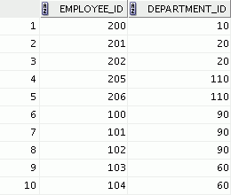
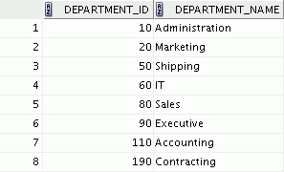
Equijoins
EMPLOYEES
DEPARTMENTS
…
Primary key
Foreign key
Notes:
Oracle Database 11g: SQL Fundamentals I F - <number>
Equijoins
To determine an employee’s department name, you compare the value in the DEPARTMENT_ID column in the EMPLOYEES table with the DEPARTMENT_ID values in the DEPARTMENTS table. The relationship between the EMPLOYEES and DEPARTMENTS tables is an equijoin; that is, values in the DEPARTMENT_ID column in both tables must be equal. Often, this type of join involves primary and foreign key complements.
Note: Equijoins are also called simple joins or inner joins.

Slide 10
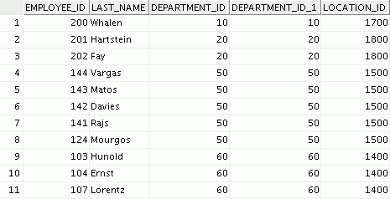
Retrieving Records with Equijoins
SELECT e.employee_id, e.last_name, e.department_id,
d.department_id, d.location_id
FROM employees e, departments d
WHERE e.department_id = d.department_id;
…
Notes:
Oracle Database 11g: SQL Fundamentals I F - <number>
Retrieving Records with Equijoins
In the example in the slide:
The SELECT clause specifies the column names to retrieve:
Employee last name, employee number, and department number, which are columns in the EMPLOYEES table
Department number, department name, and location ID, which are columns in the DEPARTMENTS table
The FROM clause specifies the two tables that the database must access:
EMPLOYEES table
DEPARTMENTS table
The WHERE clause specifies how the tables are to be joined:
e.department_id = d.department_id
Because the DEPARTMENT_ID column is common to both tables, it must be prefixed with the table alias to avoid ambiguity. Other columns that are not present in both the tables need not be qualified by a table alias, but it is recommended for better performance.
Note: When you use the Execute Statement icon to run the query, SQL Developer suffixes a “_1” to differentiate between the two DEPARTMENT_IDs.

Slide 11
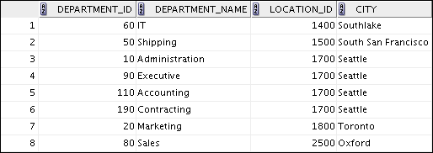
Retrieving Records with Equijoins: Example
SELECT d.department_id, d.department_name,
d.location_id, l.city
FROM departments d, locations l
WHERE d.location_id = l.location_id;
Notes:
Oracle Database 11g: SQL Fundamentals I F - <number>
Retrieving Records with Equijoins: Example
In the example in the slide, the LOCATIONS table is joined to the DEPARTMENTS table by the LOCATION_ID column, which is the only column of the same name in both the tables. Table aliases are used to qualify the columns and avoid ambiguity.

Slide 12

Additional Search Conditions
Using the AND Operator
SELECT d.department_id, d.department_name, l.city
FROM departments d, locations l
WHERE d.location_id = l.location_id
AND d.department_id IN (20, 50);
Notes:
Oracle Database 11g: SQL Fundamentals I F - <number>
Additional Search Conditions Using the AND Operator
In addition to the join, you may have criteria for your WHERE clause to restrict the rows under consideration for one or more tables in the join. The example in the slide limits the rows of output to those with a department ID equal to 20 or 50:
For example, to display employee Matos’ department number and department name, you need an additional condition in the WHERE clause.
SELECT e.last_name, e.department_id,
d.department_name
FROM employees e, departments d
WHERE e.department_id = d.department_id
AND last_name = 'Matos';

Slide 13
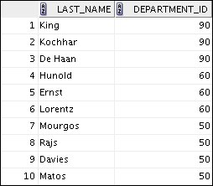
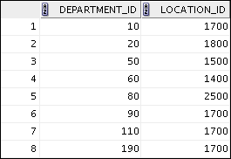
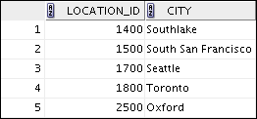
Joining More than Two Tables
EMPLOYEES
DEPARTMENTS
LOCATIONS
…
To join n tables together, you need a minimum of n–1
join conditions. For example, to join three tables, a
minimum of two joins is required.
Notes:
Oracle Database 11g: SQL Fundamentals I F - <number>
Joining More than Two Tables
Sometimes you may need to join more than two tables. For example, to display the last name, the department name, and the city for each employee, you have to join the EMPLOYEES, DEPARTMENTS, and LOCATIONS tables.
SELECT e.last_name, d.department_name, l.city
FROM employees e, departments d, locations l
WHERE e.department_id = d.department_id
AND d.location_id = l.location_id;
…

Slide 14
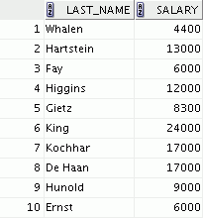
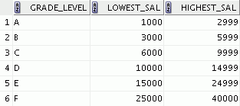

Nonequijoins
EMPLOYEES
JOB_GRADES
JOB_GRADES table defines LOWEST_SAL and HIGHEST_SAL range of values for each GRADE_LEVEL. Therefore, the GRADE_LEVEL column can be used to assign grades to each employee.
…
Notes:
Oracle Database 11g: SQL Fundamentals I F - <number>
Nonequijoins
A nonequijoin is a join condition containing something other than an equality operator.
The relationship between the EMPLOYEES table and the JOB_GRADES table is an example of a nonequijoin. The SALARY column in the EMPLOYEES table ranges between the values in the LOWEST_SAL and HIGHEST_SAL columns of the JOB_GRADES table. Therefore, each employee can be graded based on the salary. The relationship is obtained using an operator other than the equality operator (=).

Slide 15
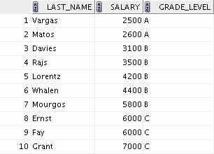
Retrieving Records with Nonequijoins
SELECT e.last_name, e.salary, j.grade_level
FROM employees e, job_grades j
WHERE e.salary
BETWEEN j.lowest_sal AND j.highest_sal;
…
Notes:
Oracle Database 11g: SQL Fundamentals I F - <number>
Retrieving Records with Nonequijoins
The example in the slide creates a nonequijoin to evaluate an employee’s salary grade. The salary must be between any pair of the low and high salary ranges.
It is important to note that all employees appear exactly once when this query is executed. No employee is repeated in the list. There are two reasons for this:
None of the rows in the job grade table contain grades that overlap. That is, the salary value for an employee can lie only between the low salary and high salary values of one of the rows in the salary grade table.
All of the employees’ salaries lie within the limits that are provided by the job grade table. That is, no employee earns less than the lowest value contained in the LOWEST_SAL column or more than the highest value contained in the HIGHEST_SAL column.
Note: Other conditions (such as <= and >=) can be used, but BETWEEN is the simplest. Remember to specify the low value first and the high value last when using the BETWEEN condition. The Oracle server translates the BETWEEN condition to a pair of AND conditions. Therefore, using BETWEEN has no performance benefits, but should be used only for logical simplicity.
Table aliases have been specified in the example in the slide for performance reasons, not because of possible ambiguity.

Slide 16
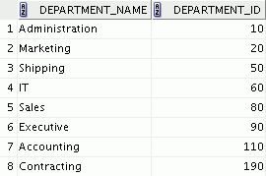
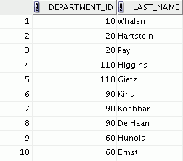

Returning Records with No Direct Match with Outer Joins
DEPARTMENTS
EMPLOYEES
…
There are no employees in department 190.
Notes:
Oracle Database 11g: SQL Fundamentals I F - <number>
Returning Records with No Direct Match with Outer Joins
If a row does not satisfy a join condition, the row does not appear in the query result. For example, in the equijoin condition of the EMPLOYEES and DEPARTMENTS tables, department ID 190 does not appear because there are no employees with that department ID recorded in the EMPLOYEES table. Similarly, there is an employee whose DEPARTMENT_ID is set to NULL, so this row will also not appear in the query result of an equijoin. To return the department record that does not have any employees, or to return the employee record that does not belong to any department, you can use the outer join.

Slide 17
Outer Joins: Syntax
  You use an outer join to see rows that do not meet the join condition.
  The outer join operator is the plus sign (+).
SELECT table1.column, table2.column
FROM table1, table2
WHERE table1.column(+) = table2.column;
SELECT table1.column, table2.column
FROM table1, table2
WHERE table1.column = table2.column(+);
Notes:
Oracle Database 11g: SQL Fundamentals I F - <number>
Outer Joins: Syntax
Missing rows can be returned if an outer join operator is used in the join condition. The operator is a plus sign enclosed with parentheses (+), and is placed on the “side” of the join that is deficient in the information. This operator has the effect of creating one or more null rows, to which one or more rows from the nondeficient table can be joined.
In the syntax:
table1.column = Is the condition that joins (or relates) the tables together
table2.column (+) Is the outer join symbol, which can be placed on either side of the WHERE clause condition, but not on both sides (Place the outer join symbol following the name of the column in the table without the matching rows.)

Slide 18
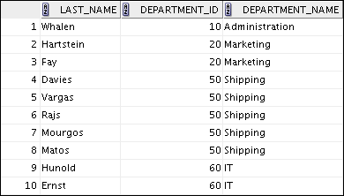

Using Outer Joins
SELECT e.last_name, e.department_id, d.department_name
FROM employees e, departments d
WHERE e.department_id(+) = d.department_id ;
…
Notes:
Oracle Database 11g: SQL Fundamentals I F - <number>
Using Outer Joins
The example in the slide displays employee last names, department IDs, and department names. The Contracting department does not have any employees. The empty value is shown in the output.
Outer Join Restrictions
The outer join operator can appear only on one side of the expression—the side in which the information is missing. It returns those rows, from one table, that have no direct match in the other table.
A condition involving an outer join cannot use the IN operator or be linked to another condition by the OR operator.
Note: Oracle’s join syntax does not have an equivalent for the FULL OUTER JOIN of the SQL:1999– compliant join syntax.

Slide 19
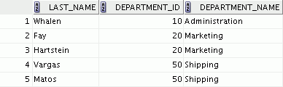
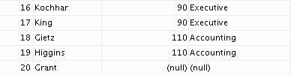
Outer Join: Another Example
SELECT e.last_name, e.department_id, d.department_name
FROM employees e, departments d
WHERE e.department_id = d.department_id(+) ;
…
Notes:
Oracle Database 11g: SQL Fundamentals I F - <number>
Outer Join: Another Example
The query in the example in the slide retrieves all rows in the EMPLOYEES table, even if there is no match in the DEPARTMENTS table.

Slide 20
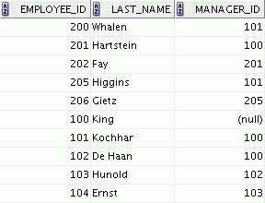
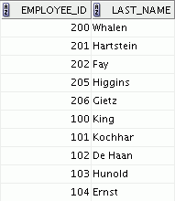
Joining a Table to Itself
EMPLOYEES (WORKER)
EMPLOYEES (MANAGER)
…
…
MANAGER_ID in the WORKER table is equal to EMPLOYEE_ID in the MANAGER table.
Notes:
Oracle Database 11g: SQL Fundamentals I F - <number>
Joining a Table to Itself
Sometimes you need to join a table to itself. To find the name of each employee’s manager, you need to join the EMPLOYEES table to itself, or perform a self-join. For example, to find the name of Lorentz’s manager, you need to:
Find Lorentz in the EMPLOYEES table by looking at the LAST_NAME column
Find the manager number for Lorentz by looking at the MANAGER_ID column. Lorentz’s manager number is 103.
Find the name of the manager with EMPLOYEE_ID 103 by looking at the LAST_NAME column. Hunold’s employee number is 103, so Hunold is Lorentz’s manager.
In this process, you look in the table twice. The first time you look in the table to find Lorentz in the LAST_NAME column and the MANAGER_ID value of 103. The second time you look in the EMPLOYEE_ID column to find 103 and the LAST_NAME column to find Hunold.

Slide 21
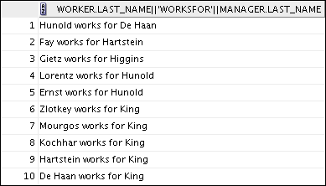
Self-Join: Example
SELECT worker.last_name || ' works for '
|| manager.last_name
FROM employees worker, employees manager
WHERE worker.manager_id = manager.employee_id ;
…
Notes:
Oracle Database 11g: SQL Fundamentals I F - <number>
Self-Join: Example
The example in the slide joins the EMPLOYEES table to itself. To simulate two tables in the FROM clause, there are two aliases, namely worker and manager, for the same table, EMPLOYEES.
In this example, the WHERE clause contains the join that means “where a worker’s manager number matches the employee number for the manager.”

Slide 22
Summary
In this appendix, you should have learned how to use joins to display data from multiple tables by using Oracle-proprietary syntax.
Notes:
Oracle Database 11g: SQL Fundamentals I F - <number>
Summary
There are multiple ways to join tables.
Types of Joins
Equijoins
Nonequijoins
Outer joins
Self-joins
Cartesian Products
A Cartesian product results in a display of all combinations of rows. This is done by omitting the WHERE clause.
Table Aliases
Table aliases speed up database access.
Table aliases can help to keep SQL code smaller by conserving memory.

Slide 23
Practice F: Overview
This practice covers the following topics:
  Joining tables by using an equijoin
  Performing outer and self-joins
  Adding conditions
Notes:
Oracle Database 11g: SQL Fundamentals I F - <number>
Practice F: Overview
This practice is intended to give you practical experience in extracting data from more than one table using the Oracle join syntax.

Slide 24
Notes:
Oracle Database 11g: SQL Fundamentals I F - <number>

